Slide 1



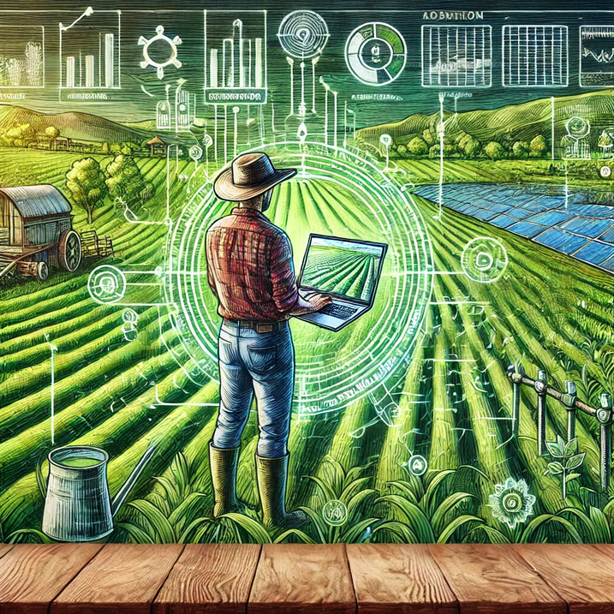



AGRIDIGI TECH (OPC)
PRIVATE LIMITED
AGRIDIGI TECH (OPC)
PRIVATE LIMITED
eKrishiKendra - Revolutionizing Indian Agriculture
VISIT US

Slide 2
OUR IDENTITY AND ASPIRATIONS
Who we are?
Vision
To be the leading digital platform that empowers every stakeholder in the agricultural sector with innovative solutions, ensuring sustainable growth and prosperity for Indian agriculture.
eKrishiKendra, a venture of AgriDigi Tech (OPC) Private Limited, is a pioneering digital agriculture platform committed to transforming the face of Indian agriculture. Founded in 2017 and incorporated in 2021, we bring together a unified network of farmers, agri-input industries, agri-experts, agri-students, and agri-bazaar under one roof.
What we do?
Mission
To provide comprehensive, accessible, and advanced agricultural services that improve productivity, enhance market linkages, and foster the overall development of the farming community through digital innovation.
We offer a comprehensive suite of services designed to address the challenges faced by the agricultural sector. From agricultural marketing and price discovery to Satellite technology-based advisory services and e-learning platforms for agri-students, eKrishiKendra is dedicated to enhancing productivity, ensuring fair pricing, and promoting sustainable farming practices.

Slide 3






KEY CHALLENGES FACING INDIAN AGRICULTURE
Indian agriculture faces critical challenges that hinder its efficiency and profitability. Addressing these issues is vital for enhancing sustainability and improving the livelihoods of millions of farmers.
Economic Viability
Average monthly farmer income stands at merely ₹10,218, with high cultivation costs leaving little for savings.
Market Access and Fair Pricing
Farmers encounter significant barriers accessing markets directly, often receiving unfair prices due to extensive middlemen involvement.
Land and Resource Constraints
Over 85% of Indian farmers manage less than 2 acres, suffering from inadequate access to water and modern tools
Climate Vulnerability
Dependence on unpredictable monsoon patterns and inadequate resilient practices lead to unstable production
Sources : Situation Assessment Survey of Agricultural Households
Soruces: IIM Study
Sources : IPCC
Sources: Agricultural Census

Slide 4
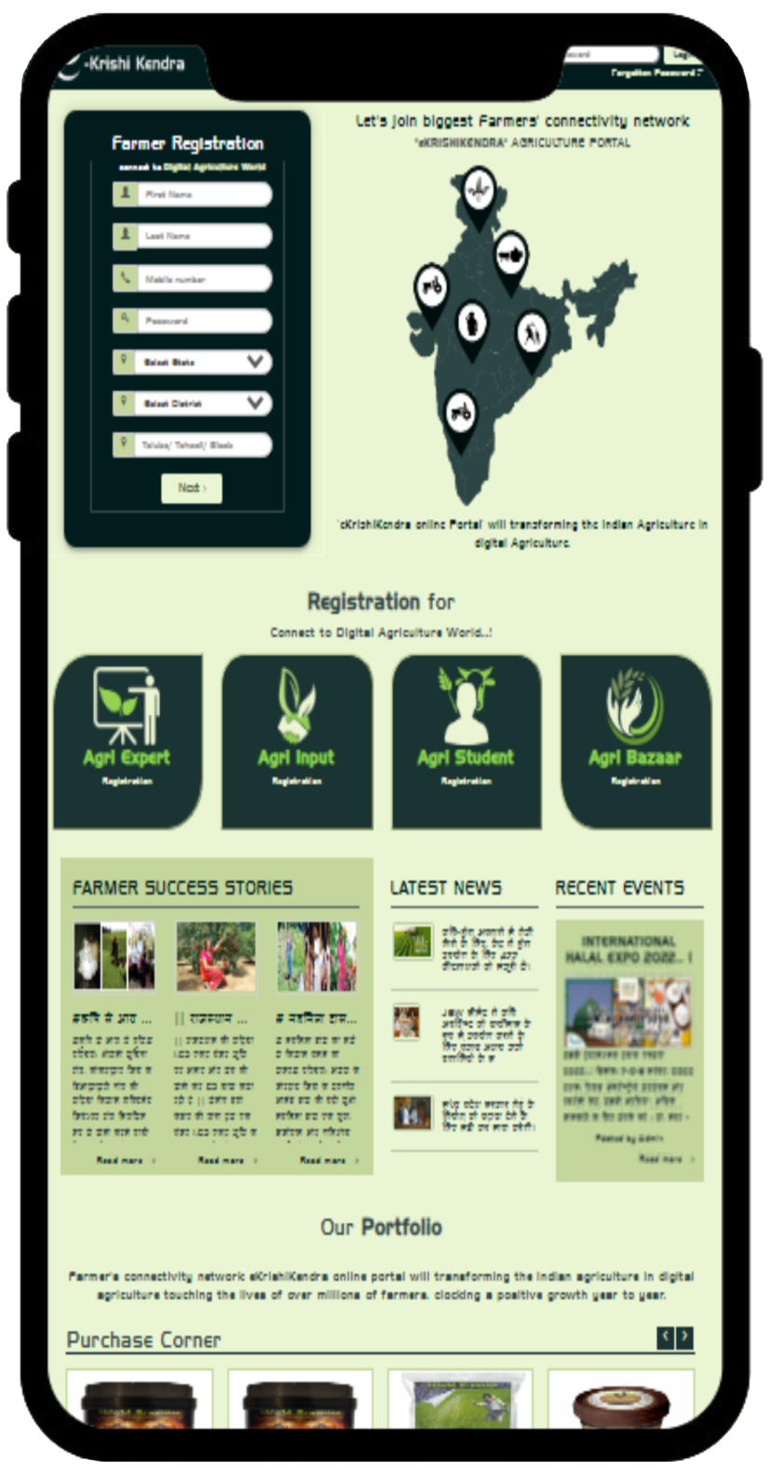

TRANSFORMATIVE SOLUTIONS FOR EMPOWERED FARMING
Satellite technology -based Advisory Services
Offering timely and accurate weather-based digital agriculture advisory services to optimize farming practices and mitigate risks. Customized recommendation for crop practices
Digitalization of Agricultural Industry
Transforming agri input businesses from traditional to digital, optimizing their operations based on real market needs and linking the value chain.
Future Trading and Price Discovery
Implementing advanced solutions for farm produce selling, price discovery, and hedging mechanisms to stabilize farmer incomes. Facilitating direct purchase from farmers, online trading, bidding, and retailing to ensure fair pricing and market access.
Agricultural Expert Support
Enabling live farmer meetings, expert agricultural advice, and solution dissemination through an integrated platform.
Digital Education and Training
Providing e-classrooms, e-libraries, and video resources for agri-students and professionals to enhance knowledge and skills.

Slide 5

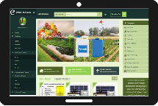

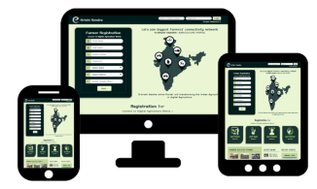
OUR PLATFORM OFFERING
Features
Farm TimeLine
satellite, IoT and AI technology-based digital agriculture advisory services.
Agri Business e-Podium
B2B commerce, dealer networks, marketing, and employee management systems.
e-Mandi
Direct purchase, online trading, bidding, and retailing platform
Agri Expert Gateway
Live farmer meetings, expert advice, and video resources.
e-Classroom & e-Library
Educational resources and video libraries for agri-students and professionals.
User Engagement & Support
24/7 Customer Support
Round-the-clock support via helpline and online chat.
Interactive Forums and Communities
Online communities and discussion forums for collaboration.
Personalized Alerts and Notifications
Timely alerts on weather, crop practices, and market prices.
Live Expert Sessions
Regular live sessions with agricultural experts.
Feedback and Improvement Mechanism
Continuous user feedback to enhance platform features.

Slide 6
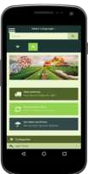

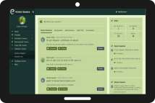
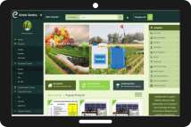
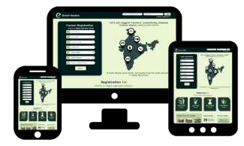
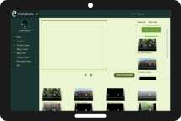
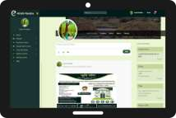
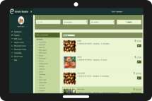
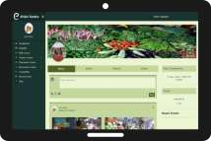
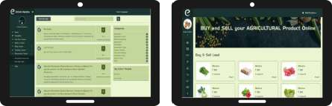
OUR PLATFORM
eKrishiKendra is a Agriculture Portal which is a unified network of farmers, Agri-input, Agri Experts, Agri Students and Agri Bazaar under single roof

Slide 7









WHAT SETS US APART
State-of-the-Art Technology
We utilize cutting-edge technology and innovative solutions to ensure our services are efficient, reliable, and scalable, setting us apart from competitors.
Customer-Centric Approach
We prioritize our clients' needs and work closely with them to provide personalized and adaptable solutions, ensuring high satisfaction and long-term partnerships.
Expert Team
Our team comprises highly skilled professionals with extensive experience in their respective fields, ensuring that we deliver top-notch services and solutions tailored to our clients' needs.
Comprehensive Service Offering
We offer a wide range of services under one roof, providing a one-stop solution for all our clients' requirements, which enhances convenience and streamlines their experience.

Slide 8
EXPLORING OUR TARGET MARKET AND POTENTIAL
SEGMENT
INDIAN MARKET
Farmers: Seeking better market access, fair pricing, and modern agricultural practices.
Agri-Bazaar: Targeting to connect buyers, retailers, traders, corporates, industrial users, exporters digitally at one place.
Agri-Input Industries: Aiming to connect with farmers to provide high-quality agricultural inputs. Looking for efficient B2B, B2C transactions, dealer networks and and market insights
Agri-Students and Professionals: Needing educational resources and expert advice to enhance their skills and knowledge.
Agri expert: Focused on improving agricultural productivity and sustainability through innovative solutions.
Projected to grow from USD 1.7 billion in 2023 to USD 4.7 billion by 2028, achieving a CAGR of 23.1%. This robust growth is driven by the rapid adoption of advanced agricultural technologies across India.
Source: Markets & Markets
GLOBAL MARKET
The global smart agriculture market size is expected to reach USD 20 billion by 2026, from USD 13 billion in 2021, at a CAGR of 9.0%. This growth is driven by the rising need for agricultural efficiency and yield improvements worldwide
Source: Grand View Research

Slide 9
COMPETITIVE LANDSCAPE IN AGRI-TECH
Features/Criteria | eKrishiKendra | AgroStar | Cropin
Marketplace | ✓ | ✓ | ✕
Localized Transactions | ✓ | ✓ | ✕
Local Market Focus | ✓ | ✕ | ✕
Real-time Data Analytics | ✓ | ✕ | ✓
Sustainable Practices | ✓ | ✕ | ✓
Automatic Satellite-Based Mapping | ✓ | ✕ | ✓
Customized Recommendations | ✓ | ✕ | ✕
Farm Timeline and Advisory Services | ✓ | ✕ | ✓
B2C, C2B, D2C | ✓ | ✓ | ✕
District crops profile | ✓ | ✕ | ✕
Agri Expert Gateway | ✓ | ✕ | ✕
e-Classroom & e-Library | ✓ | ✕ | ✕

Slide 10
REVENUE STREAMS
Primary Source of Revenue
Additional Source of Revenue
Direct Sales Model
Revenue from direct sales of farm produces and agri inputs.
Advertising and Partnerships
Revenue generated from targeted advertising for agri-input manufacturers and service providers on the platform.
Subscription Services
Monthly or annual subscriptions for premium features such as dealer networks, sales, B2B , B2C, Placement etc.
Data Analytics Services
Providing data-driven insights and analytics services to agri-businesses, researchers, and government bodies for informed decision-making.

Slide 11
FUTURE GROWTH STRATEGY
1-2 Years
3-5 Years
5+ Years
Market Expansion: Expand user base in existing markets through enhanced mobile connectivity and educational initiatives.
Feature Enhancement: Develop and deploy new features for real-time analytics and community engagement.
Inputs/Outputs: Venture into input and outputs business with the brand popularity.
Educational Partnerships: Forge partnerships with agricultural educational institutions for collaborative programs.
International Growth: Initiate expansion into neighboring countries, adapting to local agricultural needs.
Global Leadership: Position as a global leader in sustainable agricultural technology.
Policy Influence: Leverage insights to influence policy changes, promoting sustainable practices globally.

Slide 12
INVESTMENT ASK
Investment Ask: ₹40,00,000
Allocation Area | Amount (INR) | Description
Office Space | ₹2,00,000 | Renting and maintaining office space to accommodate our growing team.
App Development and Infrastructure | ₹4,00,000 | Investment in software development, maintenance, and IT infrastructure.
Marketing and Regional Expansion | ₹4,00,000 | Funding marketing initiatives and expansion activities in new regions.
Salaries for Team | ₹3,00,000 | Remuneration for existing and new staff to enhance operational capacity.
Research and Development | ₹2,00,000 | Funding innovation in agri-tech solutions and sustainability practices.
Access and Integration | ₹1,00,000 | Enhancing platform access through integration with GramOne/CSC and providing real-time market prices.

Slide 13

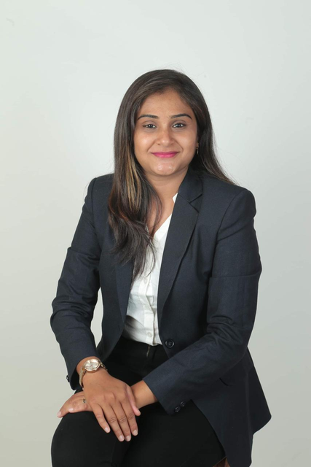
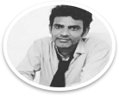
OUR LEADERSHIP TEAM
Dr Naima Shaikh
Founder & Managing Director
Narendra Savaliya
Founder & CEO
PhD in Agri Business Management & IT Professional
BE (Computer Science)
& IT Professional

Slide 14





Contact Information
Empowering sustainable agriculture through innovative technology. Contact us to learn more and join our mission.
+91 9904799905, 9375590555
eagridigitech@gmail.com
AGRIDIGI TECH (OPC) PRIVATE LIMITED

